Slide 1




Studio Shodwe
FASTAG FRAUD
DETECTION SYSTEM
Presented by: Harshit Ghosh

Slide 2


Introduction
FastTag is an electronic toll collection system in India.
It uses Radio Frequency Identification (RFID) technology for automatic toll payments.
With the increasing adoption of FastTags, fraudulent activities have also surged.
This presentation outlines our approach to detecting and preventing FastTag fraud.

Slide 3
Introduction
Fastag, a convenient RFID-based toll payment method, is unfortunately susceptible to fraud. Malicious actors can misuse Fastags in several ways, such as:
Using a Fastag meant for a lighter vehicle category on a heavier one, paying a lower toll.
Tampering with RFID tags or using stolen ones to avoid paying tolls altogether.
These fraudulent activities lead to revenue loss for toll authorities and erode trust in the Fastag system.

Slide 4



Goals
Objective 01
Objective 02
To develop a robust system for detecting fraudulent activities in FastTag transactions.
Ensure the security and reliability of the FastTag system for users and operators.
Build a machine learning model to identify fraudulent transactions.
Integrate the model into the FastTag system for real-time fraud detection.
Minimize false positives and maximize the accuracy of fraud detection.

Slide 5







Project Timeline
01
02
03
04
05
Exploratory Data Analysis (EDA)
Feature Engineering
Model Building
Model Evaluation
Deployment
Uncover Patterns
Craft Useful Data
Train Fraud Detection Model
Evaluate Model Performance
Deploy for Real-Time Use

Slide 6


Exploratory Data Analysis (EDA)
Understanding the dataset: transaction records, user details, toll plaza information, etc.
Identifying patterns and anomalies in the data.
Visualizing data to gain insights into common fraud characteristics.
Example: Plotting the frequency of transactions by time and location.

Slide 7
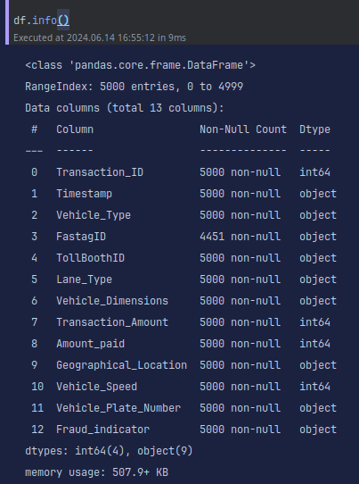
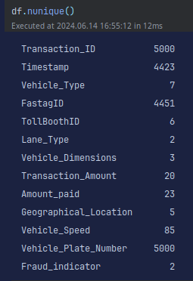
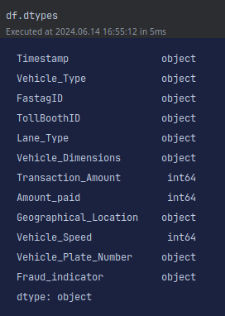
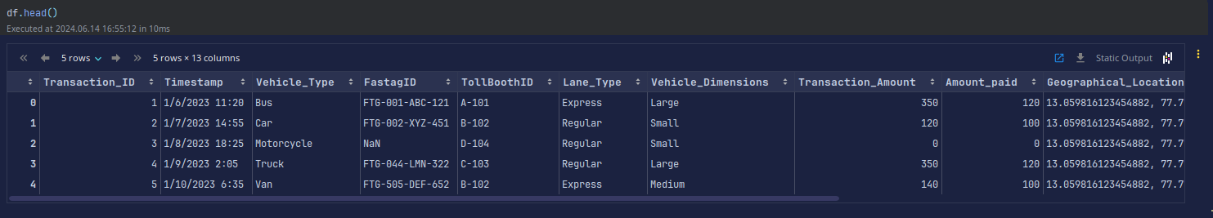
Getting Insights

Slide 8
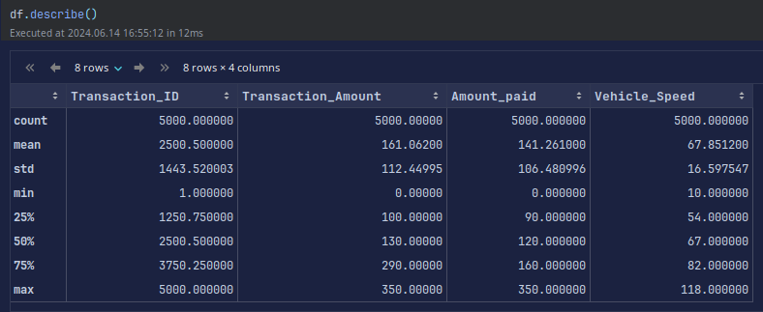
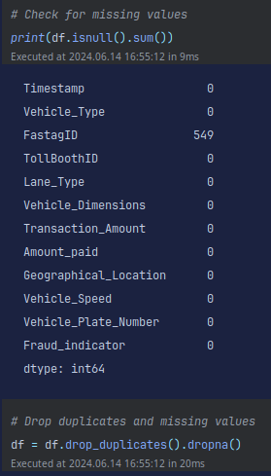
Getting Insights

Slide 9
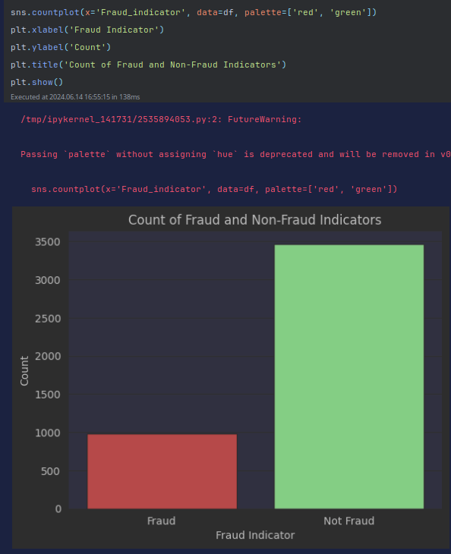
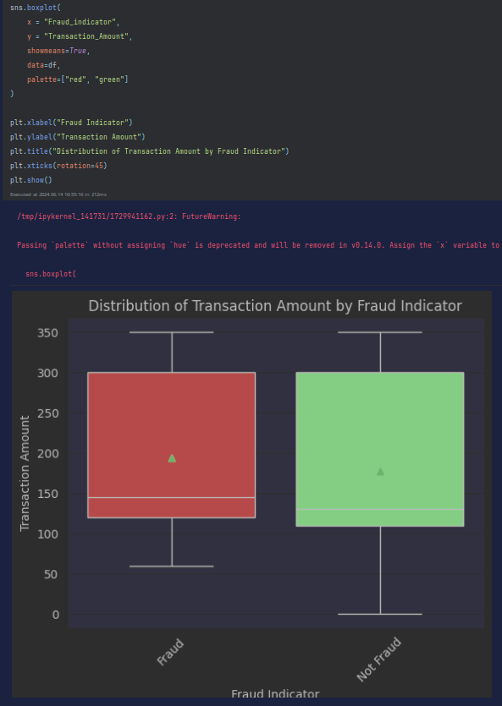
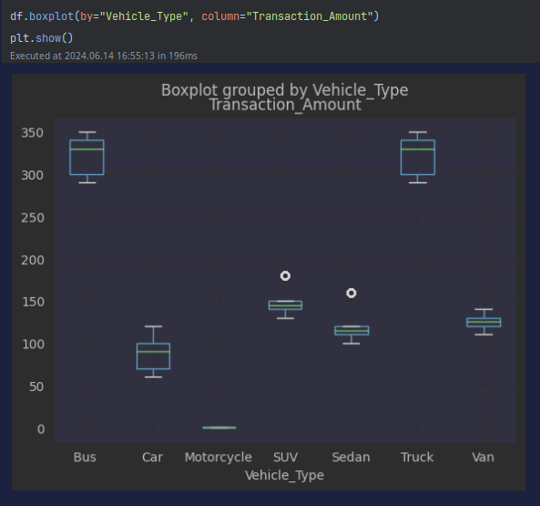
Getting Insights

Slide 10
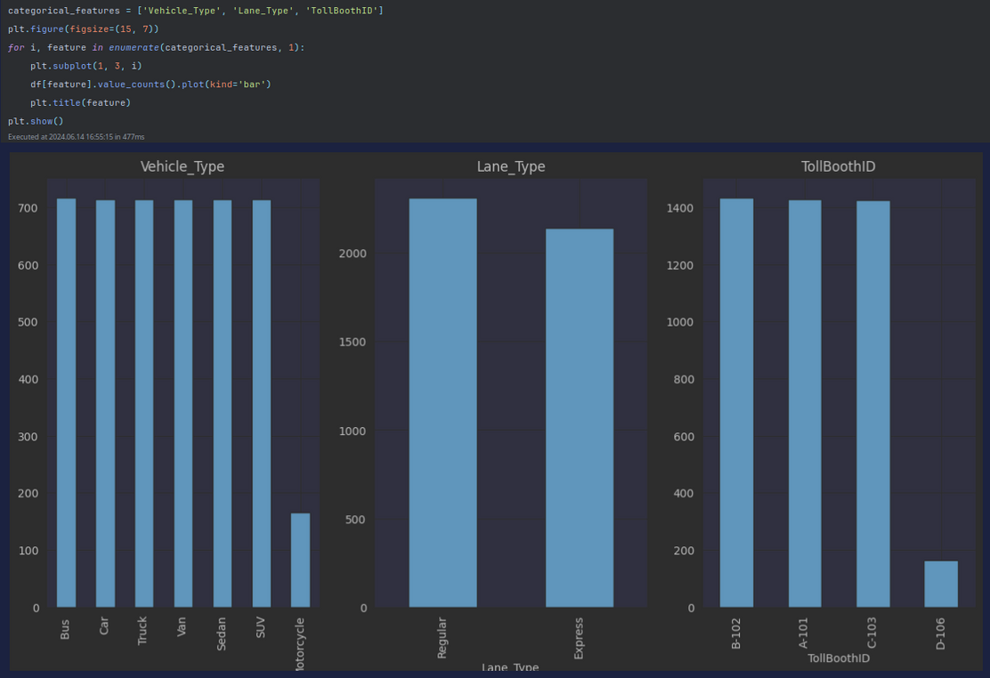
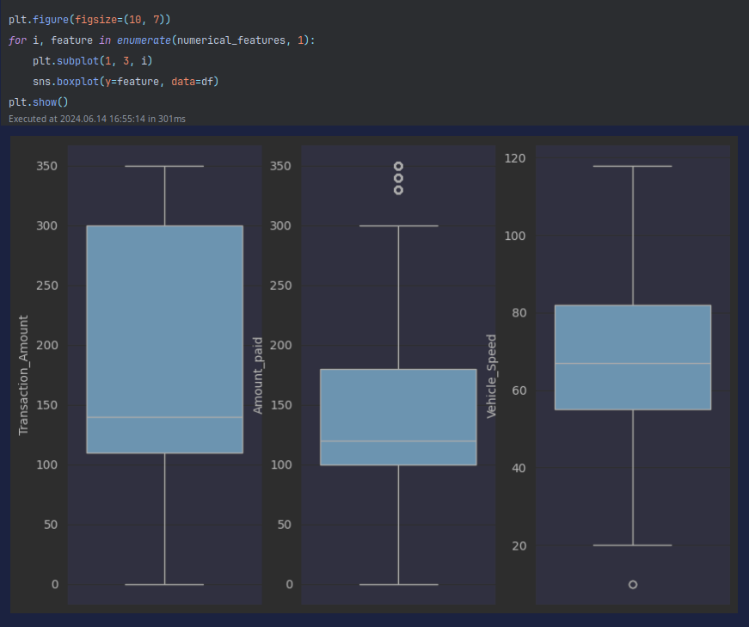
Getting Insights
box for numeric
box for cateogary

Slide 11
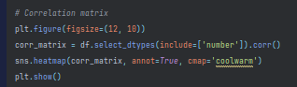
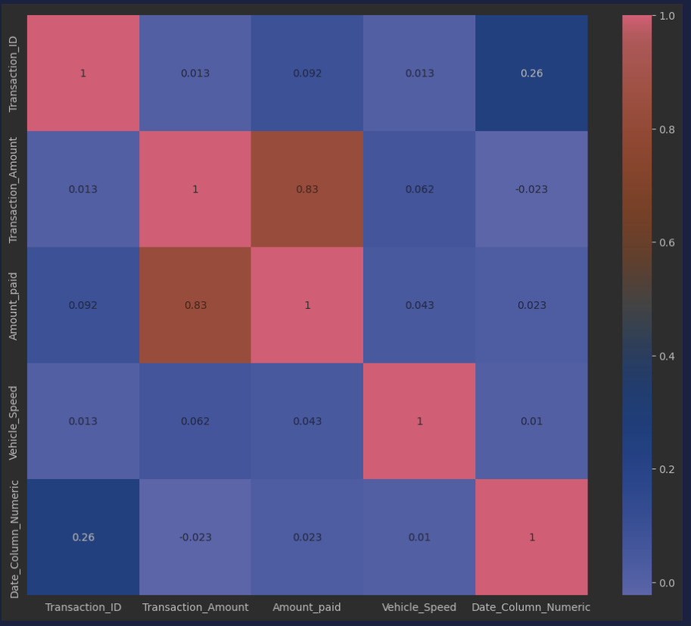
Getting Insights

Slide 12
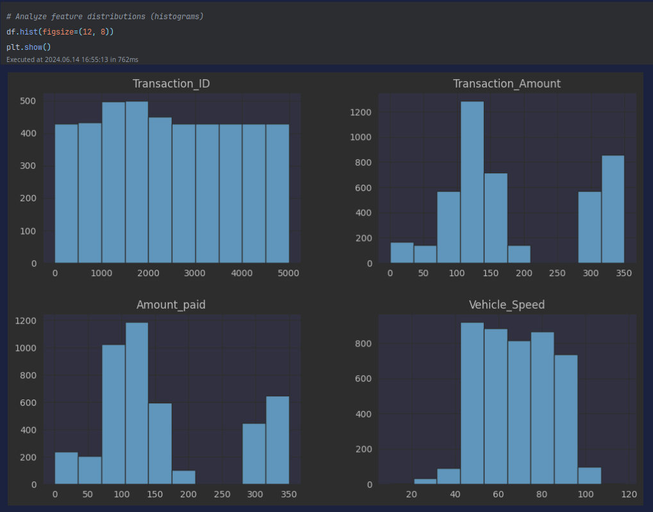
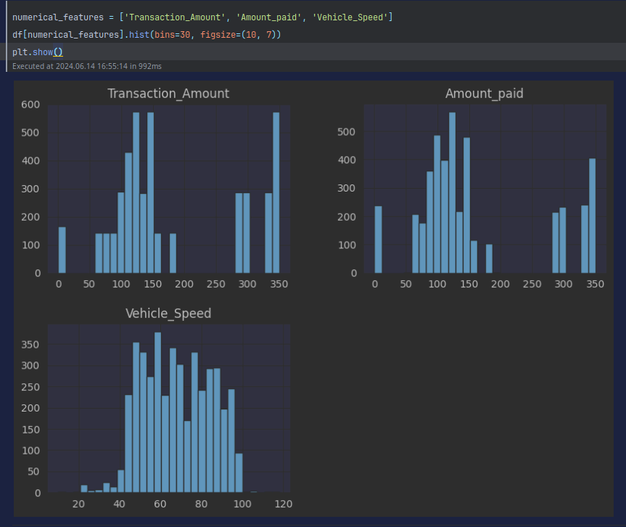
Getting Insights
Feature Distributions

Slide 13
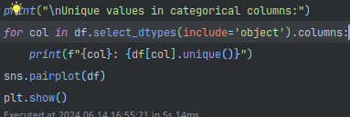
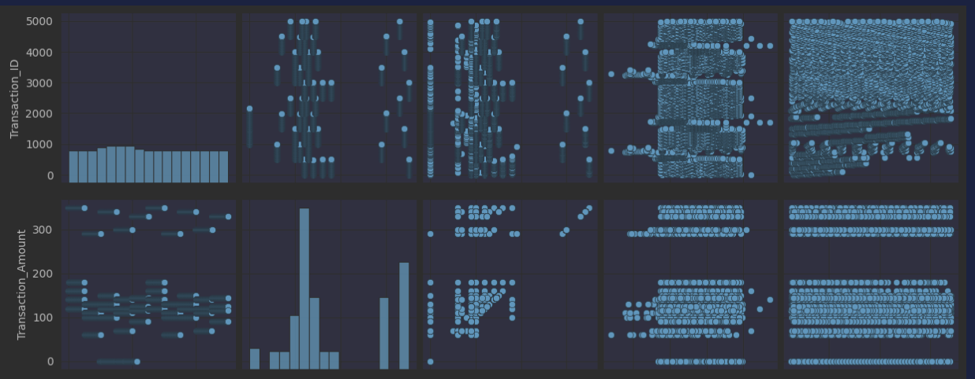
Getting Insights
Getting Unique Values

Slide 14
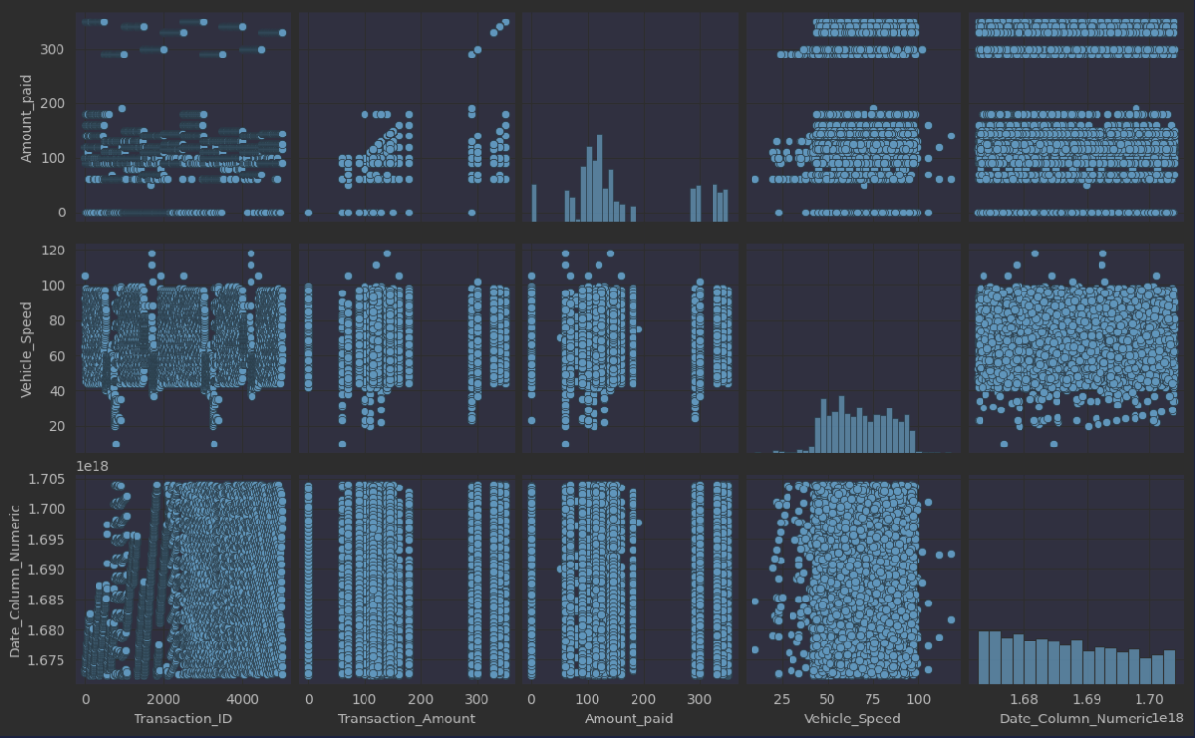
Getting Insights

Slide 15

Feature Engineering
Creating new features to enhance model performance.
Examples of features
Transaction time and frequency.
Amount patterns.
Importance of selecting relevant and impactful features.

Slide 16
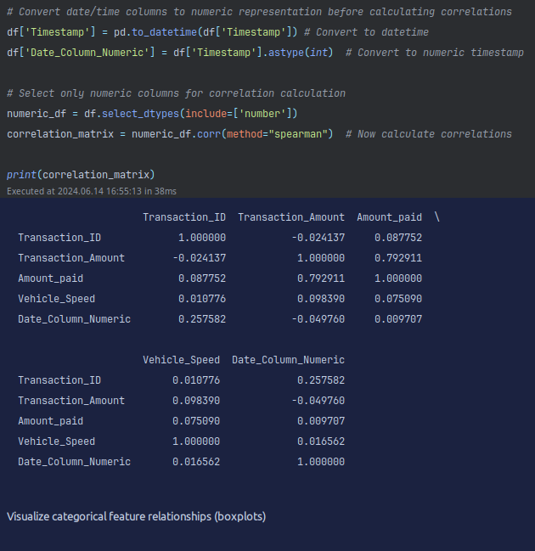
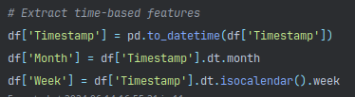
Data Conversion
Time Extraction

Slide 17
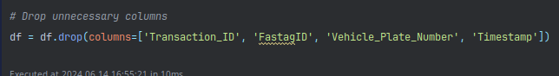
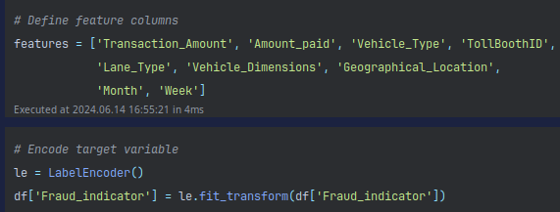

Slide 18
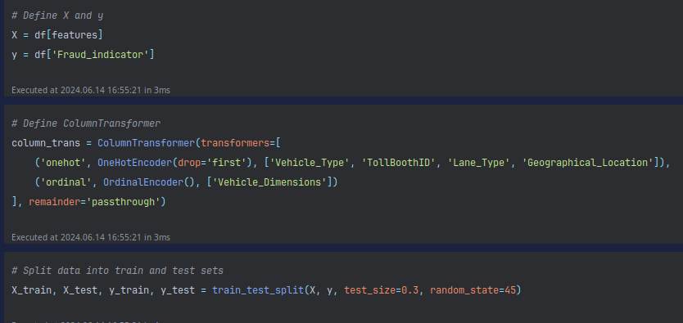
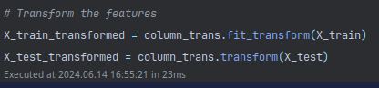
X,Y Define and Train and Split

Slide 19

Model Evaluation
Analysis
Evaluating the model using metrics such as accuracy, precision, recall, and F1-score.
Conducting cross-validation to ensure model robustness.
Analyzing the confusion matrix to understand false positives and false negatives.

Slide 20
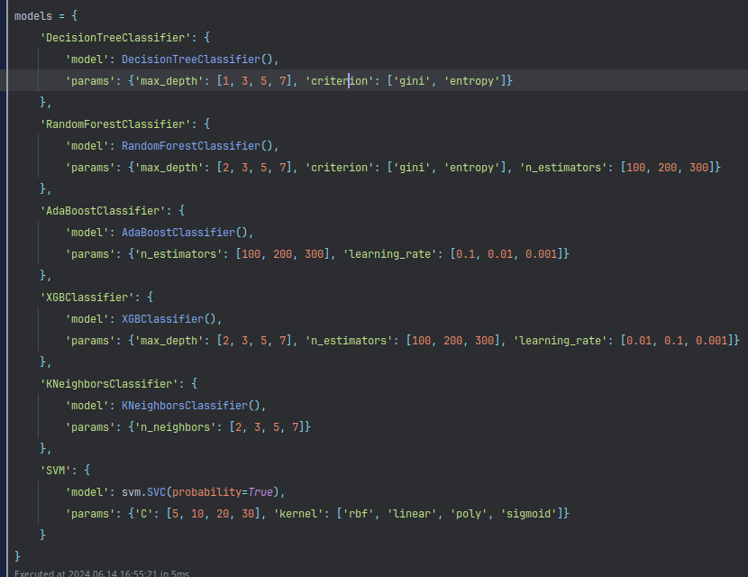
Model Declaraion and Hyperparameter

Slide 21
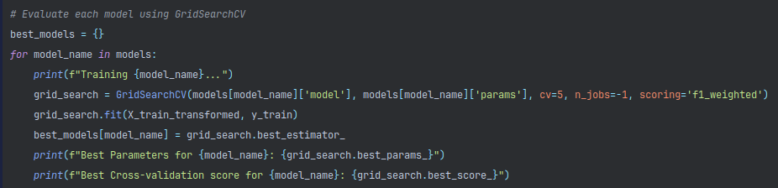
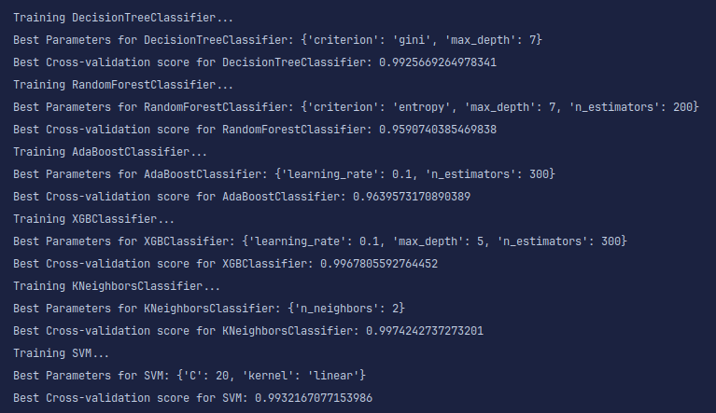
Evaluation of Best Model

Slide 22
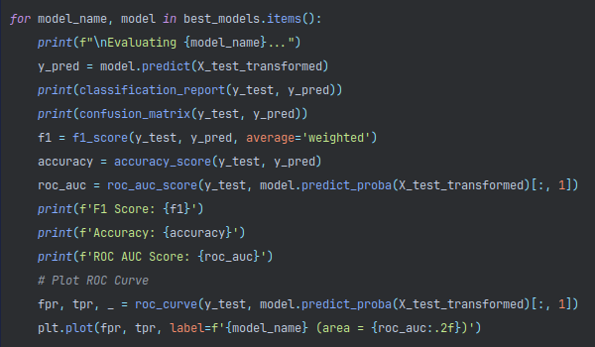
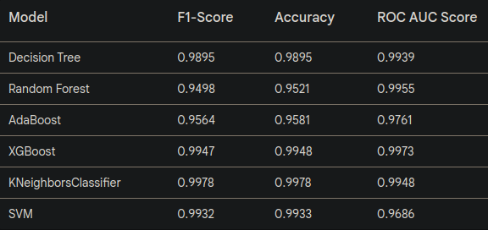
Getting All Model Score

Slide 23
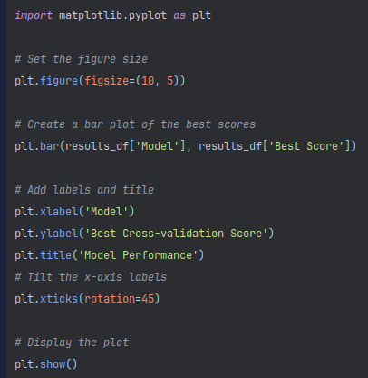
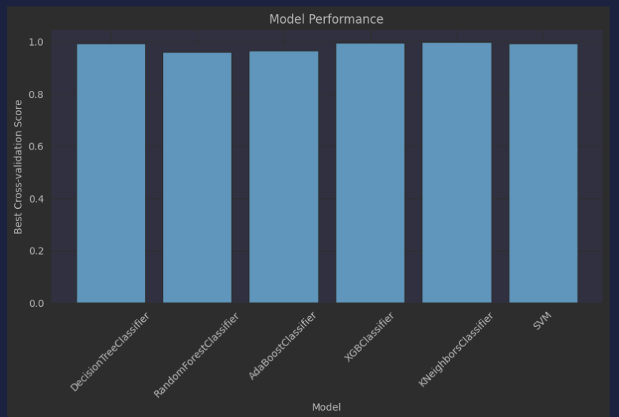
Plotting Score Of Each

Slide 24
Model Evaluation Metrics
The table shows three key performance metrics for various models:
F1-Score: The harmonic mean of precision and recall, providing a balance between the two.
Accuracy: The ratio of correctly predicted instances to the total instances.
ROC AUC Score: The Area Under the Receiver Operating Characteristic Curve, measuring the ability of the model to distinguish between classes.

Slide 25
Detailed Analysis of Each Model
Decision Tree:
The Decision Tree performs well across all metrics, but its simplicity might make it prone to overfitting.
Random Forest:
Random Forest shows good performance, particularly in terms of ROC AUC Score, indicating strong capability in distinguishing between classes. However, its F1-Score is comparatively lower.
AdaBoost:
AdaBoost has a decent balance of all three metrics but does not outperform others significantly in any single metric.

Slide 26
Detailed Analysis of Each Model
XGBoost:
XGBoost performs exceptionally well, especially in ROC AUC Score. Its F1-Score and Accuracy are also very high, making it a strong contender.
KNeighborsClassifier:
KNeighborsClassifier shows excellent performance in F1-Score and Accuracy, with a slightly lower ROC AUC Score compared to XGBoost. Its dependency on the choice of 'k' and potential computational cost might be a consideration.
Support Vector Machine (SVM):
SVM offers a high F1-Score and Accuracy, indicating a good balance between precision and recall, and overall accuracy. While its ROC AUC Score is slightly lower than some other models, it is still robust.

Slide 27
Choosing the Best Model
Why Choose SVM?
High F1-Score and Accuracy:
SVM has an F1-Score of 0.9932 and Accuracy of 0.9933, both of which are among the highest, indicating it can accurately identify fraudulent transactions with a good balance of precision and recall.
Robust Performance:
Despite having a slightly lower ROC AUC Score (0.9686), the SVM model's performance in F1-Score and Accuracy makes it a reliable choice for practical applications where precision and recall are crucial.

Slide 28
Choosing the Best Model
Why Choose SVM?
Complexity Handling:
SVM is effective in high-dimensional spaces and is particularly useful when the number of dimensions exceeds the number of samples. This is advantageous in fraud detection scenarios where transaction data might be high-dimensional.
Generalization Capability:
SVMs are known for their capacity to generalize well to unseen data, which is critical in fraud detection to avoid overfitting and ensure the model performs well on new transactions.

Slide 29
Choosing the Best Model
Why Choose SVM?
Margin Maximization:
SVM focuses on maximizing the margin between classes, which helps in creating a more defined decision boundary, reducing the risk of misclassification.
Comparison with XGBoost and KNeighborsClassifier:
XGBoost: While XGBoost has a slightly better ROC AUC Score and comparable F1-Score and Accuracy, SVM’s performance is more balanced and may generalize better in real-world scenarios.
KNeighborsClassifier: Despite the high F1-Score and Accuracy, KNeighborsClassifier might be computationally intensive and less scalable compared to SVM.

Slide 30
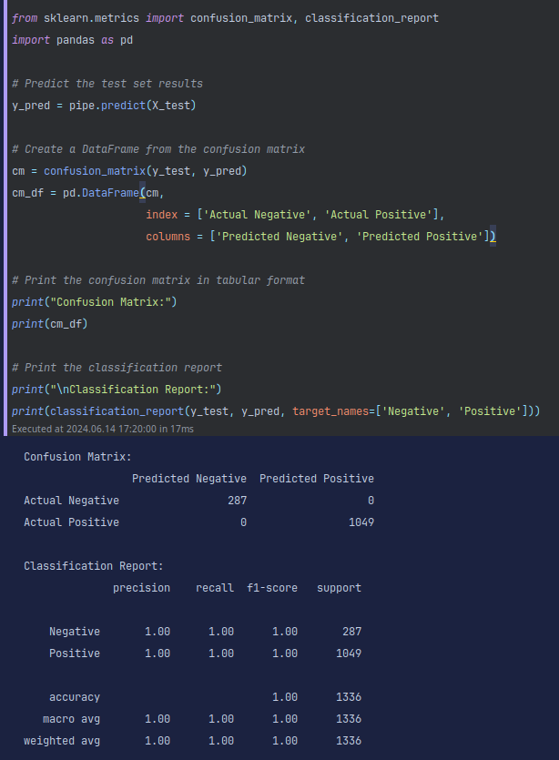
Classification

Slide 31
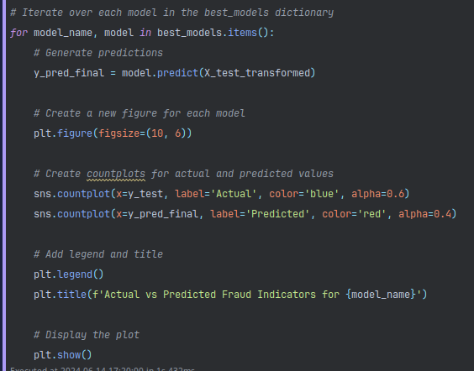
Actual vs Fraud

Slide 32
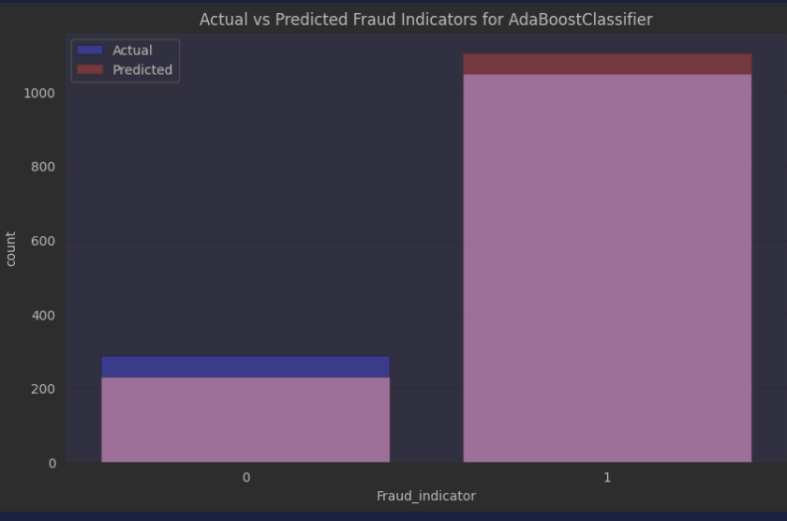
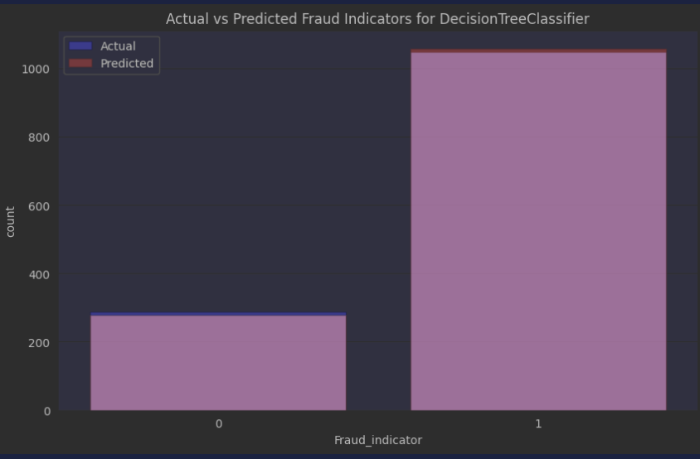
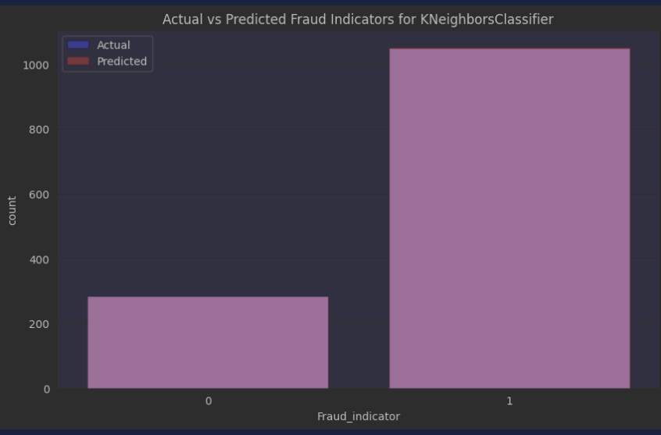
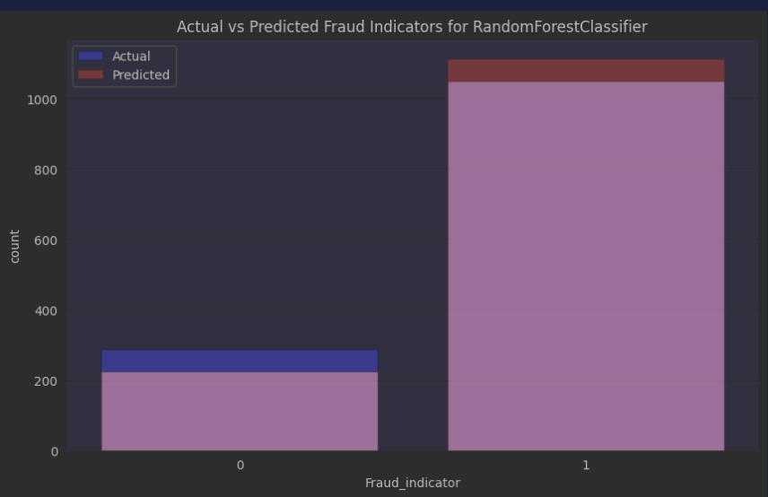
Actual vs Fraud

Slide 33
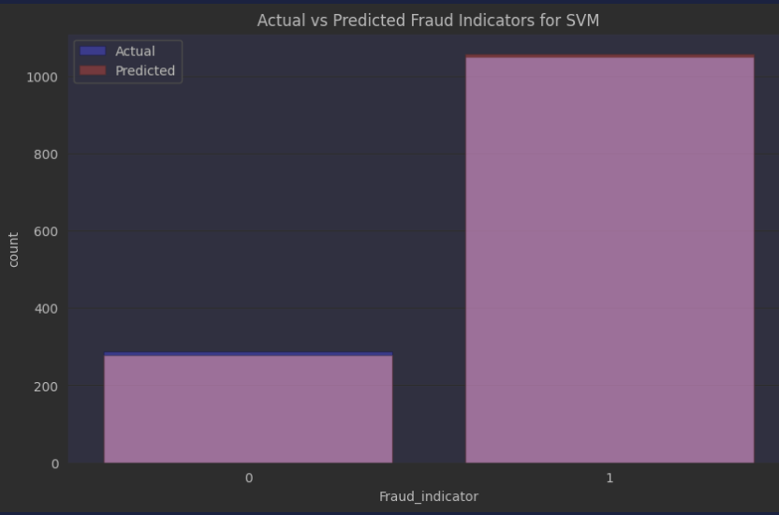
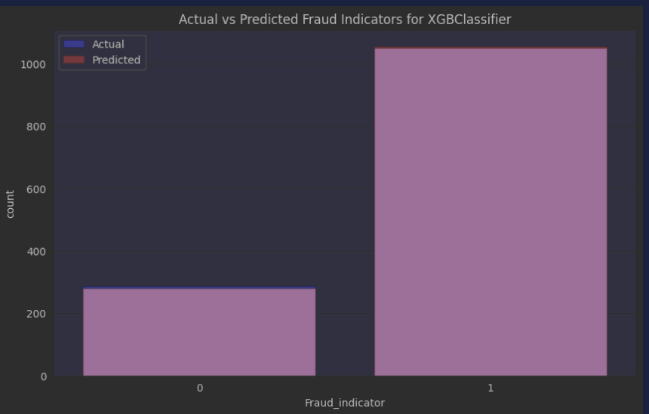

Slide 34
Model Building
Selection of appropriate machine learning algorithms (e.g., SVM, Random Forest, Neural Networks).
Training the model on historical data with known fraud labels.

Slide 35
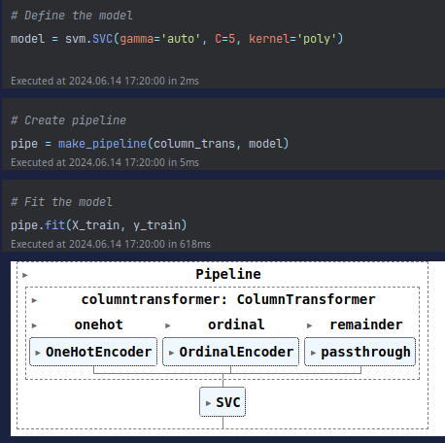
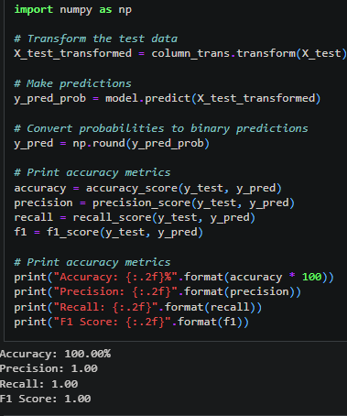
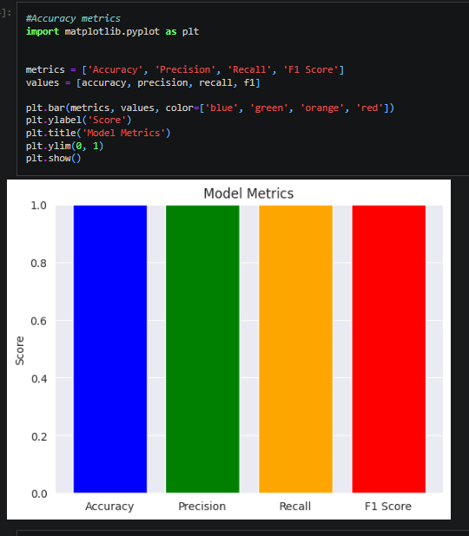
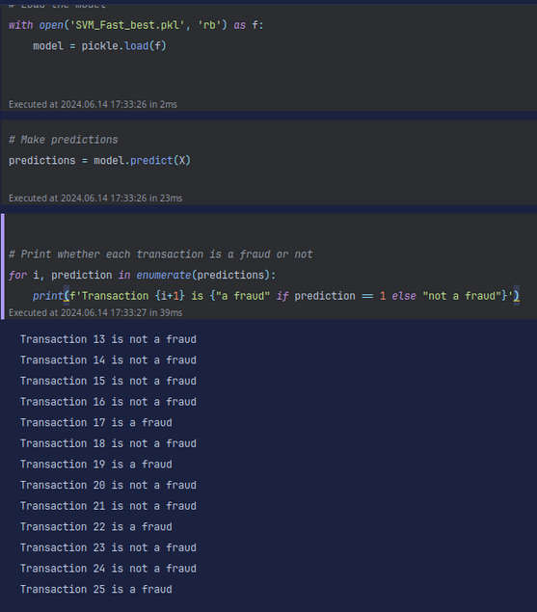

Slide 36
Deployment
Integrating the trained model into the FastTag transaction processing system.
Setting up real-time monitoring for fraud detection alerts.
Ensuring scalability and efficiency for high-volume
transaction processing.

Slide 37
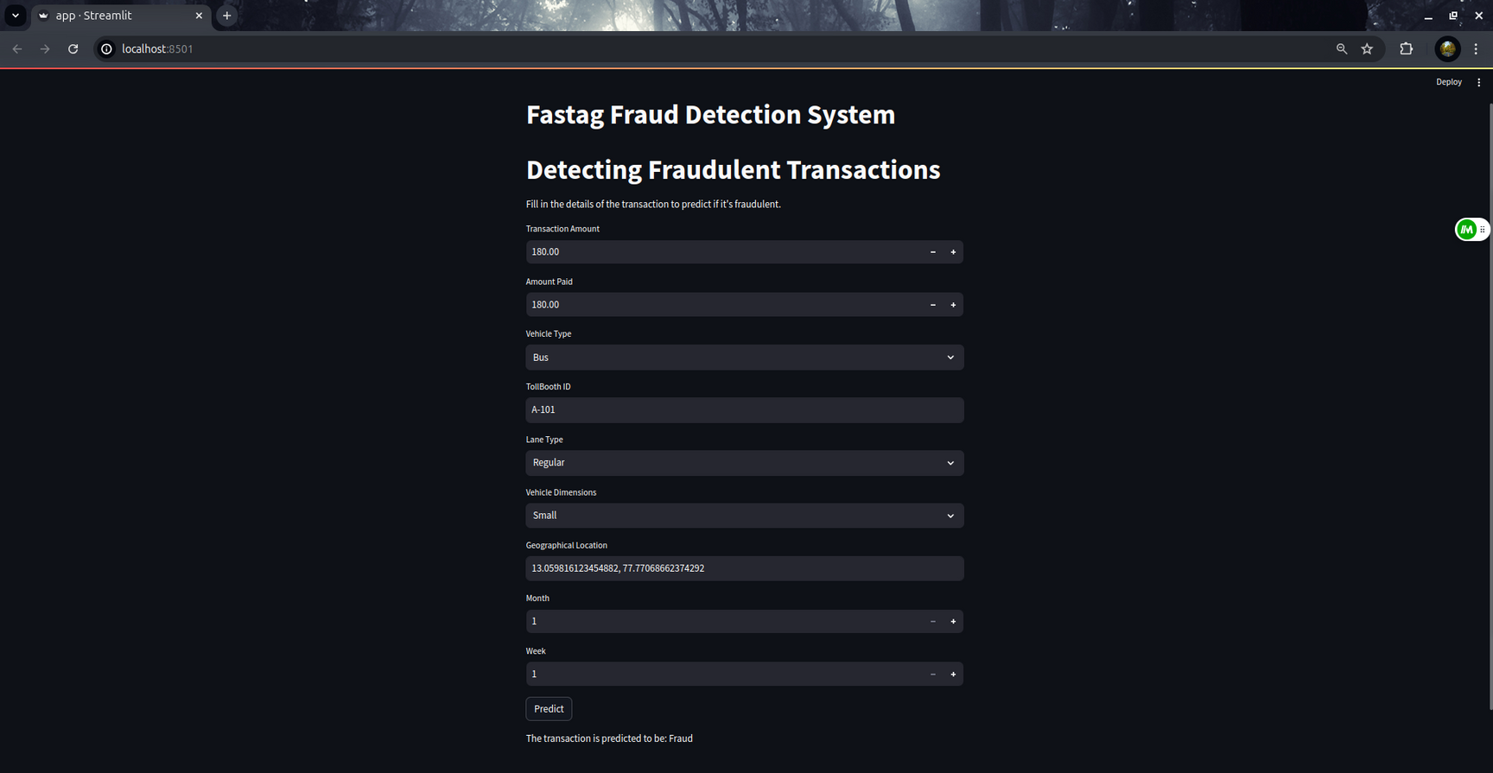

Slide 38
Benefits
Enhanced security for FastTag users.
Reduction in fraudulent transactions and financial losses.
Improved trust and reliability in the FastTag system.
Streamlined toll collection process with real-time fraud detection.
Data-driven decision-making for toll plaza operators and administrators.

Slide 39
Conclusion
FastTag fraud detection is crucial for maintaining the integrity of electronic toll collection systems.
Our approach leverages machine learning to effectively identify and prevent fraudulent transactions.
Ongoing monitoring and model updates will ensure sustained performance and adaptability to new fraud patterns.
Together, we can create a safer and more efficient toll collection experience for all stakeholders.

Slide 40
THANK YOU
For watching this presentation

